Slide 1
Topic 6 Cluster Analysis
Main Source: J. Han Book
Data Mining: Concepts and Techniques (3nd ed.)
1
Notes:
1

Slide 2
Outline
What is Cluster Analysis?
A Categorization of Major Clustering Methods
Partitioning Methods
The K-Means Algorithm for Data Clustering
Illustration with full example
Outlier Analysis
Summary
Using a tool for Data Clustering

Slide 3
Clustering
Clustering is the process of grouping the data into classes or clusters, so that objects within a cluster have high similarity in comparison to one another but are very dissimilar to objects in other clusters.
Dissimilarities are assessed based on the attribute values describing the objects. Often, distance measures are used. (Do you remember KNN?)
Clustering has its roots in many areas, including data mining, statistics, biology, and machine learning.

Slide 4
Motivating Example
Imagine that you are the Director of Customer Relationships at AllElectronics, and you have five managers working for you. You would like to organize all the company’s customers into five groups so that each group can be assigned to a different manager. Strategically, you would like that the customers in each group are as similar as possible.
Moreover, two given customers having very different business patterns should not be placed in the same group. Your intention behind this business strategy is to develop customer relationship campaigns that specifically target each group, based on common features shared by the customers per group.
What kind of data mining techniques can help you to accomplish this task?

Slide 5
Think
How we can form two teams from the students in this section to participate in a programming competition?
What kind of data mining techniques can help you to accomplish this task?

Slide 6
What is Cluster Analysis?
The process of grouping a set of physical or abstract objects into classes of similar objects is called clustering.
Cluster: a collection of data objects
Similar to one another within the same cluster
Dissimilar to the objects in other clusters
Cluster analysis
Finding similarities between data according to the characteristics found in the data and grouping similar data objects into clusters
Unsupervised learning: no predefined classes
Typical applications
As a stand-alone tool to get insight into data distribution
As a preprocessing step for other algorithms

Slide 7
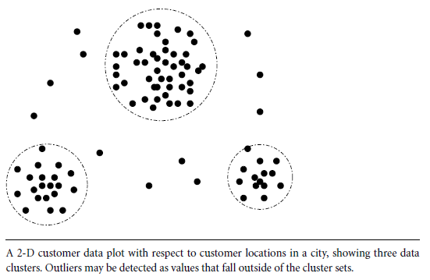
Cluster Analysis
Group data to form new categories (i.e., clusters),
Example: cluster houses to find distribution patterns
Principle: Maximizing intra-class similarity & minimizing inter-class similarity
Many methods and applications
Cluster

Slide 8
What is Cluster Analysis?
Finding groups of objects such that the objects in a group will be similar (or related) to one another and different from (or unrelated to) the objects in other groups
Inter-cluster distances are maximized
Intra-cluster distances are minimized

Slide 9
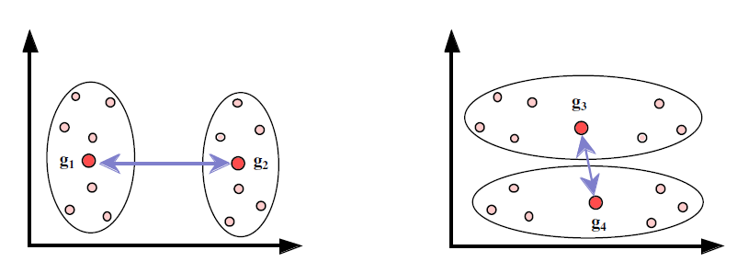
Quality: What Is Good Clustering?
A good clustering method will produce high quality clusters with
high intra-class similarity
low inter-class similarity
The quality of a clustering result depends on both the similarity measure used by the method and its implementation
The quality of a clustering method is also measured by its ability to discover some or all of the hidden patterns

Slide 10
Measure the Quality of Clustering
Dissimilarity/Similarity metric: Similarity is expressed in terms of a distance function, typically metric: d(i, j)
There is a separate “quality” function that measures the “goodness” of a cluster.
The definitions of distance functions are usually very different for interval-scaled, boolean, categorical, ordinal ratio, and vector variables.
Weights should be associated with different variables based on applications and data semantics.
It is hard to define “similar enough” or “good enough”
the answer is typically highly subjective.

Slide 11
Similarity and Dissimilarity Between Objects
Distances are normally used to measure the similarity or dissimilarity between two data objects
Some popular ones include: Minkowski distance:
where i = (x_{i1}, x_{i2}, …, x_{ip}) and j = (x_{j1}, x_{j2}, …, x_{jp}) are two p-dimensional data objects, and q is a positive integer
If q = 1, d is Manhattan distance

Slide 12
Similarity and Dissimilarity Between Objects (Cont.)
If q = 2, d is Euclidean distance:
Properties
d(i,j) ≥ 0
d(i,i) = 0
d(i,j) = d(j,i)
d(i,j) ≤ d(i,k) + d(k,j)
Also, one can use weighted distance, parametric Pearson product moment correlation, or other disimilarity measures

Slide 13
Examples of Euclidean Distances
Euclidean
Dist (x,y) = sqrt (4²+3²) = 5
y = (9,8)
3
5
Manhattan
Dist (x,y) = 4+3 = 7
4
x = (5,5)

Slide 14
Notes about Clustering Algorithms
A clustering algorithm attempts to find natural groups of components (or data) based on some similarity. Also, the clustering algorithm finds the centroid of a group of data sets.
To determine cluster membership, most algorithms evaluate the distance between a point and the cluster centroids.
The output from a clustering algorithm is basically a statistical description of the cluster centroids with the number of components in each cluster.

Slide 15
Major Clustering Approaches
Partitioning approach:
Construct various partitions and then evaluate them by some criterion, e.g., minimizing the sum of square errors
Typical methods: k-means, k-medoids, CLARANS
Hierarchical approach:
Create a hierarchical decomposition of the set of data (or objects) using some criterion
Typical methods: Diana, Agnes, BIRCH, ROCK, CAMELEON

Slide 16
Partitional Clustering
Original Points
A Partitional Clustering

Slide 17
Hierarchical Clustering
Traditional Hierarchical Clustering
Traditional Dendrogram
Non-traditional Hierarchical Clustering
Non-traditional Dendrogram

Slide 18
Hierarchical Clustering
Build a tree-based hierarchical taxonomy from a set of unlabeled examples.
Recursive application of a standard clustering algorithm can produce a hierarchical clustering.
animal
vertebrate
invertebrate
fish reptile amphib. mammal worm insect crustacean

Slide 19
Partitioning Algorithms: Basic Concept
Partitioning method: Construct a partition of a database D of n objects into a set of k clusters.
Given a k, find a partition of k clusters that optimizes the chosen partitioning criterion
Heuristic methods: k-means and k-medoids algorithms
k-means (MacQueen’67): Each cluster is represented by the center of the cluster
k-medoids or PAM (Partition around medoids) (Kaufman & Rousseeuw’87): Each cluster is represented by one of the objects in the cluster

Slide 20
The K-Means Clustering Algorithm
K-Means algorithm introduced by J.B. MacQueen in 1967, is one of the most common clustering algorithms that groups data with similar characteristics or features together.
The K-Means algorithm is a statistical unsupervised clustering technique. All input attributes to the algorithm must be numeric and the user is required to make a decision about how many clusters are to be discovered.

Slide 21
The K-Means Clustering Method (1)
1) Initially, the number of clusters must be known, or chosen, to be K say.
2) The initial step is the choose a set of K instances as centres of the clusters. Often chosen such that the points are mutually “farthest apart”, in some way.
3) Next, the algorithm considers each instance and assigns it to the cluster which is closest.
4) The cluster centroids are recalculated using one of two methods either:
1) after each instance assignment, or
2) after the whole cycle of re-assignments.
5) This process is iterated.
We use this option
First Way

Slide 22
The K-Means Clustering Method (2)
Given k, the k-means algorithm is implemented in four steps:
1) Partition objects into k nonempty subsets
2) Compute seed points as the centroids of the clusters of the current partition (the centroid is the center, i.e., mean point, of the cluster)
3) Assign each object to the cluster with the nearest seed point
4) Go back to Step 2, stop when no more new assignment
Second Way

Slide 23
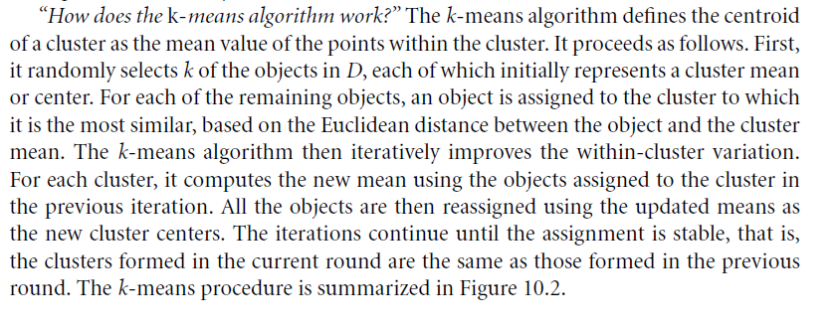
The K-Means: From Book

Slide 24
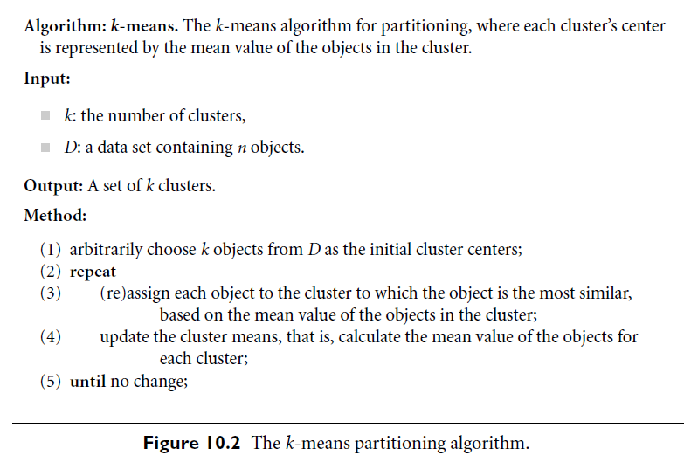

The K-Means: From Book

Slide 25
K-Means Algorithm: We have 4 variations
A) For finding the initial clusters we have two options:
Option 1: Select the first K points randomly and assign them as the centroid of the K clusters, then start clustering. (Default)
Option 2: Partition the points into K folds and assign each fold to a cluster, then find the centroid for each cluster, then start clustering.
B) For updating the centroid of the clusters we have two options:
Option 1: Update the centroid after each assignment of a point. (Default)
Option 2: Update the centroid at the end of each iteration (Cycle).

Slide 26
Illustration of the K-Means Clustering Method
Example
10
10
9
9
8
8
7
7
6
6
5
5
4
Assign each objects to most similar center
Update the cluster means
4
3
3
2
2
1
1
0
0
0
1
2
3
4
5
6
7
8
9
10
0
1
2
3
4
5
6
7
8
9
10
reassign
reassign
K=2
Arbitrarily choose K object as initial cluster center
Update the cluster means

Slide 27
K-Means Algorithm: Example 1
For a very simple example of five points in two dimensions, observe Fig. below. Suppose we assign the points 1, 2, 3, 4, and 5 in that order, with k = 2. Then the points 1 and 2 are assigned to the two clusters, and become their centroids for the moment.
1
5
a
3
c
2
4
b

Slide 28
K-Means Algorithm: Discussion of Example 1
When we consider point 3, suppose it is closer to 1, so 3 joins the cluster of 1, whose centroid moves to the point indicated as a.
Suppose that when we assign 4, we find that 4 is closer to 2 than to a, so 4 joins 2 in its cluster, whose center thus moves to b.
Finally, 5 is closer to a than b, so it joins the cluster {1; 3}, whose centroid moves to c.

Slide 29
K-Means Clustering: Example 2 (1)
Q) Suppose that we are given the following 9 items to cluster:
{2, 4, 10, 12, 3, 20, 30, 11, 25}
and suppose that K=2 (C1 and C2).
Solution Steps:
We initially assign the means to the first two values:
m1 = 2 and m2 =4.
Using Euclidean distance, we find that initially
C1 = {2, 3} and C2 = {4, 10, 12, 20, 30, 11, 25}.
Note: The value 3 is equally close to both means, so we arbitrarily choose K1. Any desired assignment could be used in the case of ties.
We then recalculate the means to get m1=2.5 and m2=16.
We again make assignments to clusters to get:
C1= {2, 3, 4} and C2 = {10, 12, 20, 30, 11, 25}.
Note: In this Example we re-calculate the centroid after we assign each value.
Notes:
1) m1-x1=d1, i.e. 2-2=0 vs m2-x1=4-2=2; ➔ x1 belongs to K1. m1-x2=d2, i.e. 2-4=2 vs m2-x2= 4-4=0; ➔x2 belongs to K2, etc.
m1= (2+3)/2 = 2.5; m2 = (4+10+12+20+30+11+25)/7 = 112/7 = 16.

Slide 30
K-Means Clustering: Continue Example 2 (2)
(Dunham, 2003)
Continuing in this fashion, we obtain the following:
m1 | m2 | C1 | C2
3 | 18 | {2, 3, 4, 10} | {12, 20, 30, 11, 25}
4.75 | 19.6 | {2, 3, 4, 10, 11, 12} | {20, 30, 25}
7 | 25 | {2, 3, 4, 10, 11, 12} | {20, 30, 25}
Note that the clusters in the last two steps are identical. This will yield identical means, and thus the means have converged.
Our answer is thus C1 = {2, 3, 4, 10, 11, 12} and C2 = {20, 30, 25}.

Slide 31
Example 2:
Given the following data set (D),
Cluster the instances into 2 clusters using K-Means clustering method and the Euclidian distance. (Use First Way)
 | A1 | A2
X1 | 10 | 14
X2 | 8 | 11
X3 | 12 | 13
X4 | 14 | 18
X5 | 16 | 3
X6 | 5 | 6
X7 | 7 | 8
To be Solved at Class
Note: In this Example re-calculate the centroid after we assign each instance.

Slide 32
Example 5:
Given the following data set (D),
Cluster the instances into 2 clusters using K-Means clustering method and the Euclidian distance. (Use Second Way)
 | A1 | A2
X1 | 10 | 15
X2 | 8 | 11
X3 | 12 | 12
X4 | 15 | 18
X5 | 16 | 3
X6 | 4 | 6
X7 | 9 | 8
To be Solved at Class
Note: In this Example re-calculate the centroid after we assign each instance.

Slide 33
Exercise / Home Work
Given the following data set,
Cluster the instances into 3 clusters using K-Means clustering and the Euclidian distance.
Cluster the instances into 2 clusters using K-Means clustering and the Euclidian distance.
Cluster the instances into 3 clusters using K-Means clustering and the Manhattan distance.
Try the same example using WEKA/Orange.
Note: You need to Convert the data set into ARFF format.
A1 | A2 | A3
10 | 14 | 5
9 | 11 | 6
12 | 12 | 7
15 | 18 | 3
16 | 3 | 4
4 | 6 | 5
6 | 8 | 10
17 | 9 | 11
8 | 13 | 15
7 | 17 | 5
10 | 9 | 6
11 | 17 | 3

Slide 34
Comments on the K-Means Method
Strength: Relatively efficient: O(tkn), where n is # objects, k is # clusters, and t is # iterations. Normally, k, t << n.
Comparing: PAM: O(k(n-k)² ), CLARA: O(ks² + k(n-k))
Comment: Often terminates at a local optimum. The global optimum may be found using techniques such as: deterministic annealing and genetic algorithms
Weakness
Applicable only when mean is defined, then what about categorical data?
Need to specify k, the number of clusters, in advance
Unable to handle noisy data and outliers
Not suitable to discover clusters with non-convex shapes

Slide 35
Variations of the K-Means Method (K-Modes)
A few variants of the k-means which differ in
Selection of the initial k means
Dissimilarity calculations
Strategies to calculate cluster means
Handling categorical data: k-modes (Huang’98)
Replacing means of clusters with modes
Using new dissimilarity measures to deal with categorical objects
Using a frequency-based method to update modes of clusters
A mixture of categorical and numerical data: k-prototype method
K-Modes: To be presented by one of the good students with Complete example.

Slide 36
Example for K-Modes:
Given the following data set (D),
Cluster the instances into 2 clusters using K-Modes clustering method and the Euclidian distance. (Use Second Way)
 | A1 | A2
X1 | Good | Yes
X2 | Bad | Yes
X3 | Good | No
X4 | Good | Yes
X5 | Bad | Yes
X6 | Bad | Yes
X7 | Bad | No
To be Solved at Class
Note: In this Example re-calculate the centroid after we assign each instance.

Slide 37
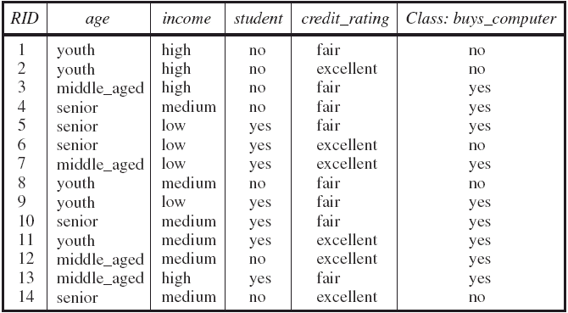
Exercise / Home Work (K-Modes):
Given the following data set (D), Cluster the instances into 2 clusters using K-Modes clustering method.

Slide 38
What Is the Problem of the K-Means Method?
The k-means algorithm is sensitive to outliers !
Since an object with an extremely large value may substantially distort the distribution of the data.
K-Medoids: Instead of taking the mean value of the object in a cluster as a reference point, medoids can be used, which is the most centrally located object in a cluster.
10
10
9
9
8
8
7
7
6
6
5
5
4
4
3
3
2
2
1
1
0
0
1
2
3
4
5
6
7
8
9
10
0
0
1
2
3
4
5
6
7
8
9
10

Slide 39
Clustering: Rich Applications and Multidisciplinary Efforts
Pattern Recognition
Spatial Data Analysis
Create thematic maps in GIS by clustering feature spaces
Detect spatial clusters or for other spatial mining tasks
Image Processing
Economic Science (especially market research)
WWW
Document classification
Cluster Weblog data to discover groups of similar access patterns

Slide 40
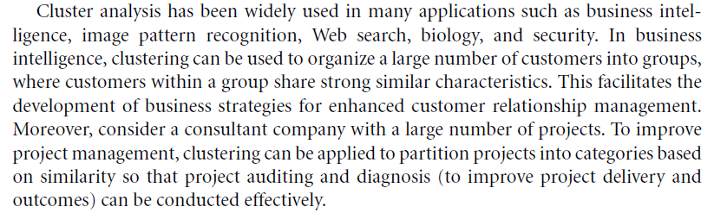
Where we can use Clustering (1)

Slide 41
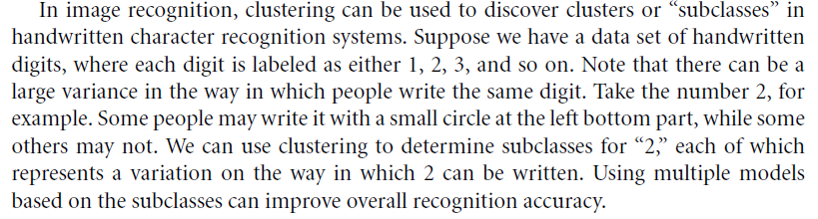
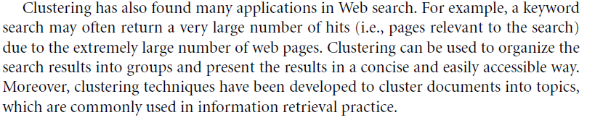
Where we can use Clustering (2)

Slide 42
Other Examples of Clustering Applications
Marketing: Help marketers discover distinct groups in their customer bases, and then use this knowledge to develop targeted marketing programs
Land use: Identification of areas of similar land use in an earth observation database
Insurance: Identifying groups of motor insurance policy holders with a high average claim cost
City-planning: Identifying groups of houses according to their house type, value, and geographical location
Earth-quake studies: Observed earth quake epicenters should be clustered along continent faults

Slide 43
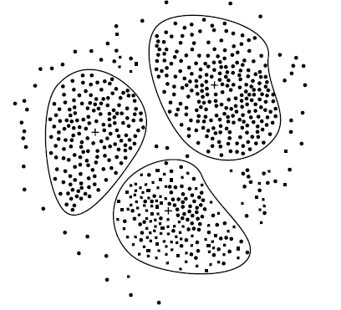
Outlier Analysis

Slide 44
Outlier Analysis: Introduction
Outlier:
(A) A data object that does not comply with the general behavior of the data (OR)
(B) The set of objects are considerably dissimilar from the remainder of the data
Outlier: is it Noise or exception? ―
One person’s garbage could be another person’s treasure
Methods:
by product of clustering or
regression analysis, …
Problem: Define and find outliers in large data sets
Applications:
Credit card fraud detection
Telecom fraud detection
Customer segmentation
Medical analysis

Slide 45
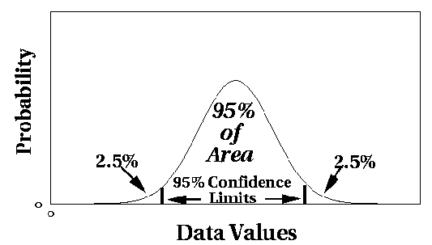
Outlier Discovery: (1) Statistical Approaches
Assume a model underlying distribution that generates data set (e.g. normal distribution)
Use discordancy tests depending on
data distribution
distribution parameter (e.g., mean, variance)
number of expected outliers
Drawbacks
most tests are for single attribute
In many cases, data distribution may not be known
Note: To be presented by one of the good students with Complete example.

Slide 46
Outlier Discovery: (2) Distance-Based Approach
Introduced to counter the main limitations imposed by statistical methods
We need multi-dimensional analysis without knowing data distribution
Distance-based outlier: A DB(p, D)-outlier is an object O in a dataset T such that at least a fraction p of the objects in T lies at a distance greater than D from O
Algorithms for mining distance-based outliers
Index-based algorithm
Nested-loop algorithm
Cell-based algorithm
Note: To be presented by one of the good students with Complete example.

Slide 47
Outlier Discovery: (3) Deviation-Based Approach
Identifies outliers by examining the main characteristics of objects in a group.
Objects that “deviate” from this description are considered outliers
A) Sequential exception technique
simulates the way in which humans can distinguish unusual objects from among a series of supposedly like objects.
B) OLAP data cube technique
uses data cubes to identify regions of anomalies in large multidimensional data.
Note: To be presented by one of the good students with Complete example.

Slide 48
Summary
Cluster analysis groups objects based on their similarity and has wide applications
Measure of similarity can be computed for various types of data
Clustering algorithms can be categorized into partitioning methods, hierarchical methods, density-based methods, grid-based methods, and model-based methods
Outlier detection and analysis are very useful for fraud detection, etc. and can be performed by statistical, distance-based or deviation-based approaches
There are still lots of research issues on cluster analysis

Slide 49
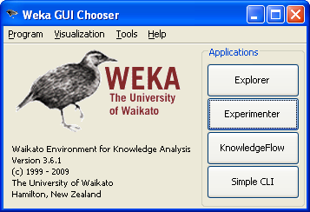
In Class Practical Session for Data Clustering Using K-Means Algorithm

Slide 50
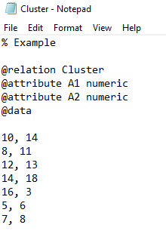
Clustering Using WEKA

Slide 51
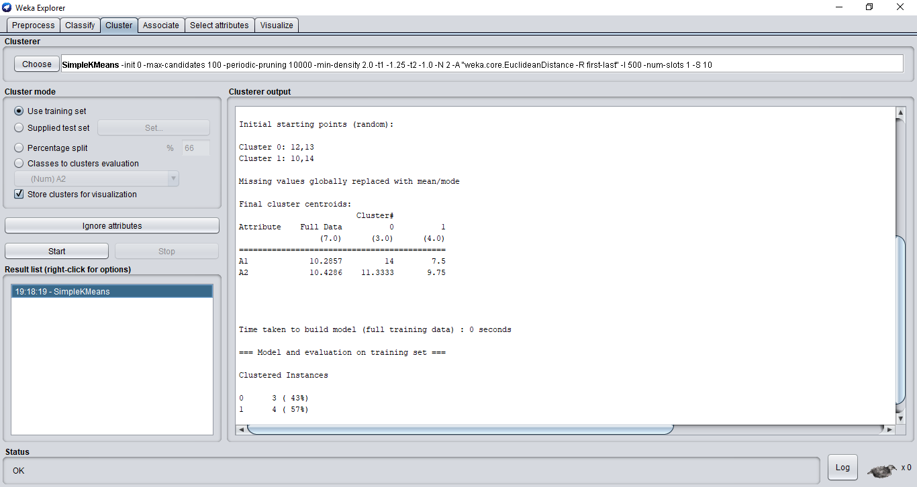
Clustering Using WEKA

Slide 52
Clustering Using WEKA
Example:
http://facweb.cs.depaul.edu/mobasher/classes/ect584/weka/k-means.html
Watch this video:
https://www.youtube.com/watch?v=HCA0Z9kL7Hg
Or this simple One:
https://www.youtube.com/watch?v=h4uDBubp29s

